Slide 1
Workplace Ergonomics
Jacqueline D. Dunson
Columbia Southern University

Slide 2

Introduction
Ergonomics generally refers to the workplace designing science with consideration of the limitations and capabilities of employees.
A systematic ergonomics improvement process should always be put in place to remove all risk factors in workplace.
Each organization has a specific strategy of ensuring organizations safety.
Notes:
It is the responsibility of the management of every organization to ensure that their employees are safe which will result in increased human performance and productivity.
All ergonomic issues identified within the workplace should be eliminated using the best systematic improvement process (Amah & Ahiauzu, 2013).

Slide 3

Issues Noted Regarding the Workstation
High repetition
Forceful Executions
Repetitive/Sustained Awkward Postures
Notes:
One of the issues I noted is that most of the work task in the workstation were repetitive and were mostly controlled by hours due to the existence of production targets an aspect that could bring harm to the employees.
Additionally, many of the tasks required human body high force loads.
Lastly, I also noted that most of the workers were sitting in awkward postures which could be much harm to them and could even lead to Musculoskeletal Disorders or MSDs (Van Eerd, et al., 2016).

Slide 4

Strategies for Improving the Safety of the Employees
Creation of an ergonomics program
Regular Workplace inspection
Employees training
Record maintenance
Notes:
The most effective strategy that the Workstation requires is a world-class ergonomics program since it would bring impact to the entire organizations and acts as a strategic continuous improvement process.
However, the management can engage in other strategies such as doing regular inspections at the work station, regularly training the employees on improvement processes within the workplace as well as training all new workers, and lastly the management can also engage in maintaining records of all training activities, incident investigations, inspections and many more workstation activities (Workplace Ergonomics 101 | ErgoPlus, n.d.).

Slide 5

Benefits of Ergonomics process
Cost reduction
Increased productivity
Increased quality
Improved employee engagement
Creation of better safety culture
Notes:
An effective ergonomics process with precisely be much beneficial to the organization especially in the long-run.
With systematic reduction of ergonomic risk factors, the organization precisely reduce its costs (costs utilized in compensating workers), production will precisely increase, the quality of output with significantly improve, the engagement of the employees with increase substantially, and lastly, a much safer culture will be created (Workplace Ergonomics 101 | ErgoPlus, n.d.).

Slide 6
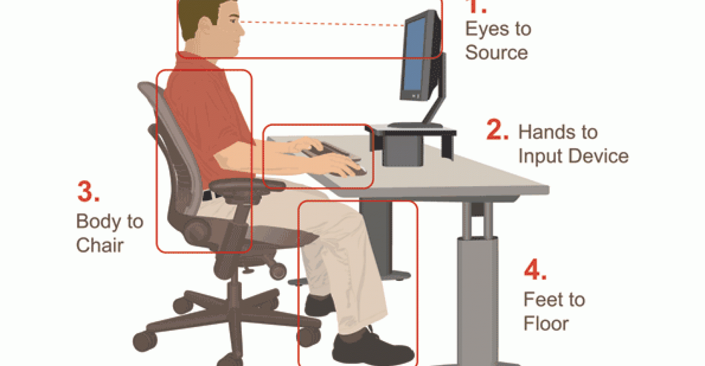
Goals of a Proactive Ergonomics Process
Identification of employees safety risks
Reduction of all the risk factors using different controls including administrative and engineering controls before any injury to the employee occurs.
Notes:
Precisely, a proactive ergonomics process usually makes identification of any ergonomic risk that might be intending to arise at the workplace and effectively uses any of the two common controls to ensure that the risk is mitigated before any injury occurs (Van Eerd, et al., 2016).

Slide 7

Steps of Ergonomics Improvement Process to Implement
Step 1: Jobs for Ergonomic Analysis prioritization
Step 2: Conduction Ergonomic Analysis
Step 3: Development of a Ergonomic Opportunity List
Notes:
There are several steps that I do recommend for the management of the workstation to followed to implement a world-class Ergonomics improvement process.
First, the list for the prioritized jobs should be developed by the Ergonomic team by conducting an employee survey or using safety data available.
Secondly, they need you to conduct an ergonomic analysis which will help identify the risks of each job in the work station hence being able to develop a precise ergonomic opportunity list.
Thirdly, an ergonomic opportunity list should be developed to help in prioritizing the organization resources paving the way for effective control measures for identified risks to be put in place (Workplace Ergonomics 101 | ErgoPlus, n.d.).

Slide 8

Steps of Ergonomics Improvement Process to Implement Con't
Step 4: Determining the Best Solution with Team Approach
Step 5: Obtaining the final approval and implement solution
Step 6: Evaluating the Ergonomic Improvement for effectiveness
Notes:
Step four of the program is to determine the best controls for implementation that can be precisely done by a multi-disciplinary team.
Next, a cost justification needs to be done if the improvement requires a capital expenditure for approval to be awarded.
Lastly, after all the improvements are put in place, the loop on the project should be precisely closed by an evaluation of the ergonomic improvement and measurement of its effectiveness (Workplace Ergonomics 101 | ErgoPlus, n.d.).

Slide 9

Ergonomic Assessment
WISHA Lifting Calculator
NIOSH Lifting Equation
Rapid Entire Body Assessment (REBA)
Notes:
Various ergonomic assessment methods are much essential to the management of the workstation.
The WISHA lifting calculator can effectively be used in combination with the NIOSH lifting equation for adequate assessment.
They are effective in the assessment of manual material handling risks that are associated with lowering and listing tasks in the workstation.
Rapid Entire Body Assessment can also be used which uses a systematic process to conduct the entire body evaluation to identify any safety risks associated with the job the employee is undertaking (Workplace Ergonomics 101 | ErgoPlus, n.d.).

Slide 10
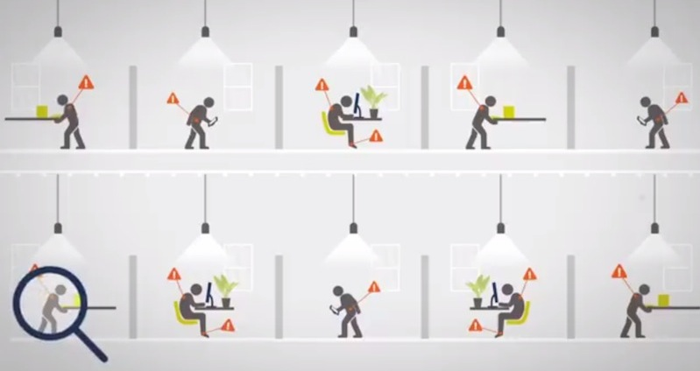
Ergonomic Assessment Con't
Rapid Upper Limb Assessment (RULA)
Liberty Mutual Manual Material Handling Tables (Snook Tables)
Washington State Ergonomic and MSD Risk Assessment Checklist
Notes:
Rapid Upper Limb Assessment usually makes an assesses the postural and biomechanical load requirement of job demands and tasks on the upper extremities including the trunk and the neck.
Liberty Mutual Manual Material Handling Tables can also be much helpful in assessment since it helps in making a comparison of data of each specific manual handling tasks against an appropriate table.
Assessment of ergonomic risk factors including hand-arm vibration, lifting, repeated impacts, high hand force, highly repetitive motions, and awkward postures can all be done using Washington State Ergonomic and MSD Risk Assessment Checklist (Ahmed, 2018).

Slide 11
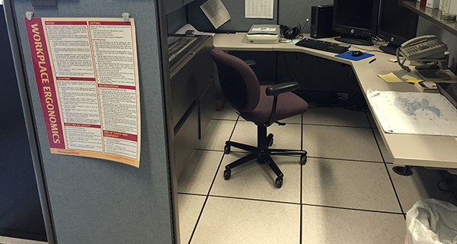
Ergonomic Controls
Engineering Controls
Administrative Controls
Notes:
Engineering controls and Administrative controls are the two broadly used ergonomic control tools. Usually, the engineering controls reduce and even eliminates awkward postures via ergonomic modifications since it seeks maintenance of a joint range of motion in the efforts of accomplishing work tasks within the mid-range of motion positions for vulnerable joints (Ahmed, 2018).

Slide 12
References
Amah, E., & Ahiauzu, A. (2013). Employee involvement and organizational effectiveness. Journal of Management Development, 32(7), 661-674.
Van Eerd, D., King, T., Keown, K., Slack, T., Cole, D. C., Irvin, E., ... & Bigelow, P. (2016). Dissemination and use of a participatory ergonomics guide for workplaces. Ergonomics, 59(6), 851-858.
Ahmed, F. (2018). Improving workplace safety through ergonomic intervention-a case study of a readymade garment industry.
Workplace Ergonomics 101 | ErgoPlus. (n.d.). Retrieved from https://ergo-plus.com/workplace-ergonomics/

